Slide 1
Data Structures
Lecture 6
Queue
Prantik Paul [PNP]
Lecturer
Department of Computer Science and Engineering
BRAC University

Slide 2
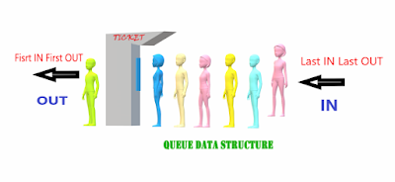
Queue (in real life)

Slide 3
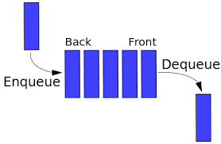
Queue (Data Structure)

Slide 4
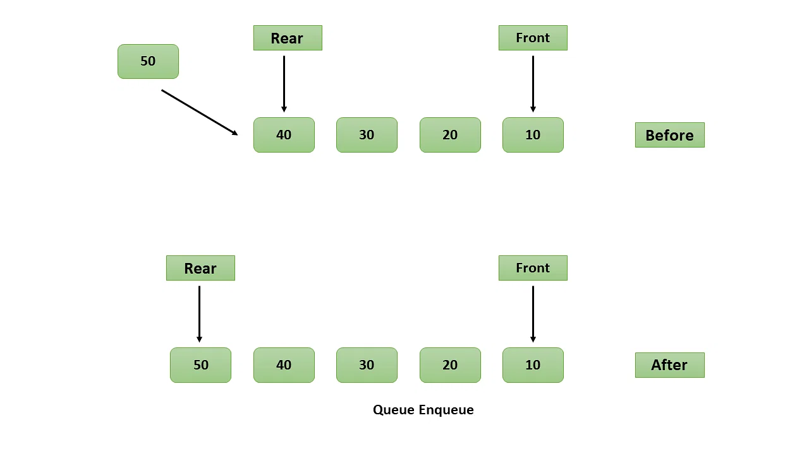
Queue (Enqueue)

Slide 5
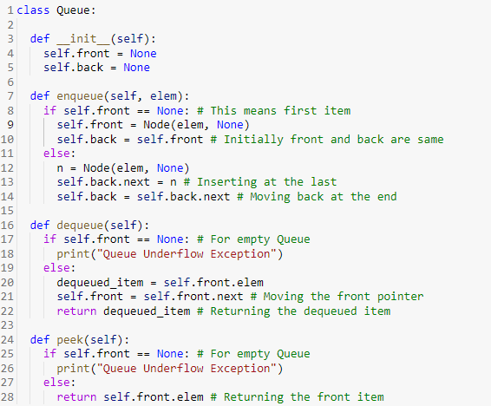
Queue (Enqueue)

Slide 6
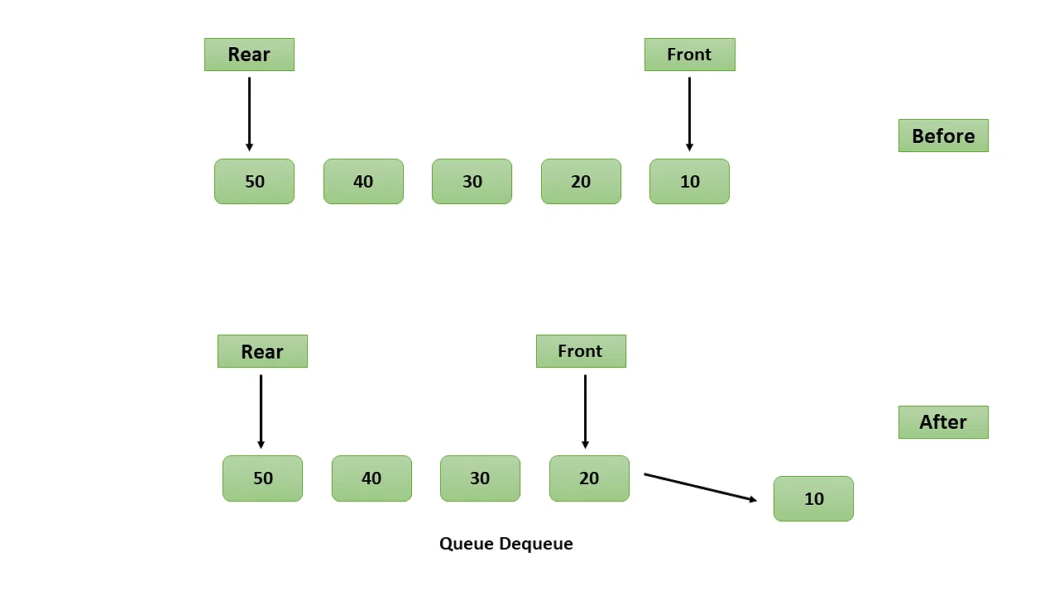
Queue (Dequeue)

Slide 7
Queue (Dequeue)

Slide 8
Queue (Peek)

Slide 9
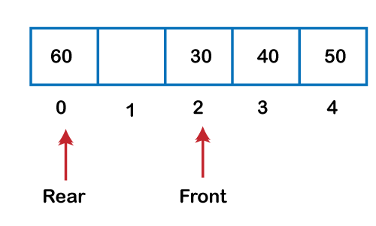
Circular Array

Slide 10
Circular Array (Indexing)
a = buffer[4 % 5]
a = buffer[(4 + 2) % 5]
a = buffer[(0 - 2) %5]

Slide 11
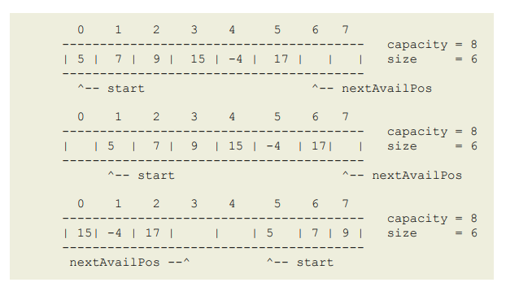
Circular Array (Structure)

Slide 12
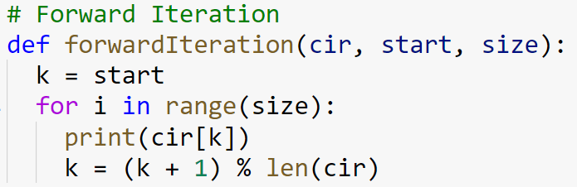
Circular Array (Iteration - Forward)

Slide 13
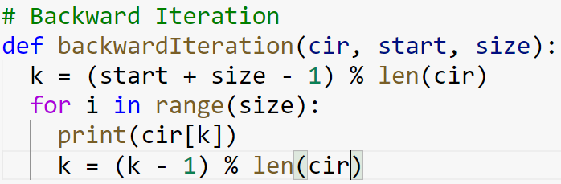
Circular Array (Iteration - Backward)

Slide 14
Circular Array (Insertion)
Offset i index = (start + i) % len(cir)
Last index = (start + size - 1) % len(cir)
Next available index = (start + size) % len(cir)

Slide 15
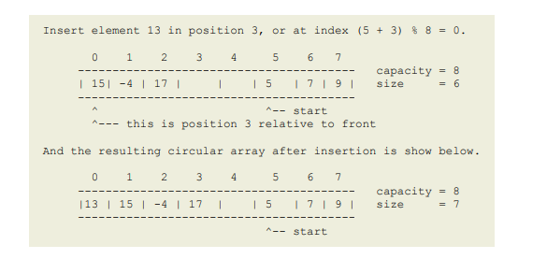
Circular Array (Insertion)

Slide 16
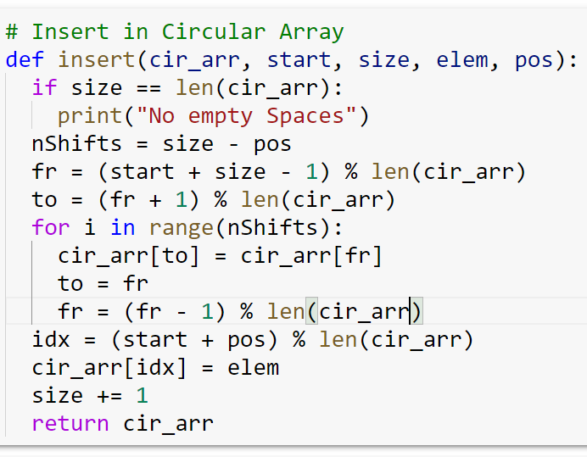
Circular Array (Insertion)

Slide 17
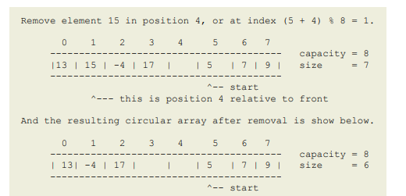
Circular Array (Remove)

Slide 18
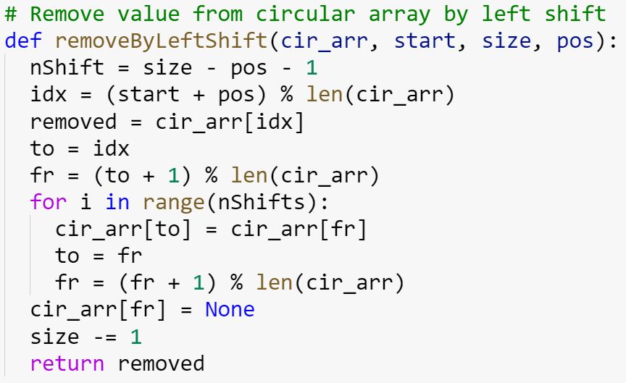
Circular Array (Remove)

Slide 19
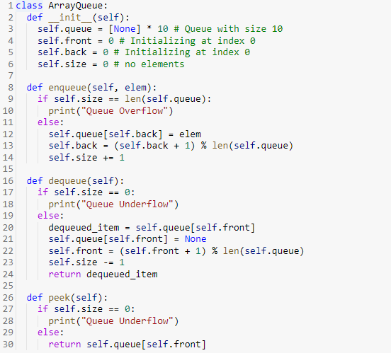
Queue (with Array)

Slide 20
Queue (Enqueue)

Slide 21
Queue (Dequeue)

Slide 22
Queue (Peek)

Slide 23
Queue Simulation
len(array) = 4
enqueue a, enqueue b, dequeue, peek, enqueue c, peek, dequeue

Slide 24
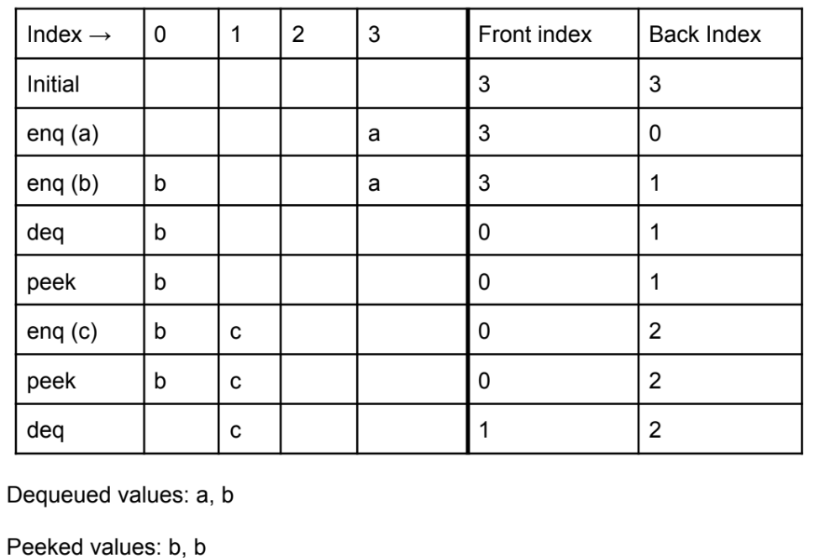
Queue Simulation
enqueue a, enqueue b, dequeue, peek, enqueue c, peek, dequeue
len(array) = 4
Start index = 3

